Slide 1
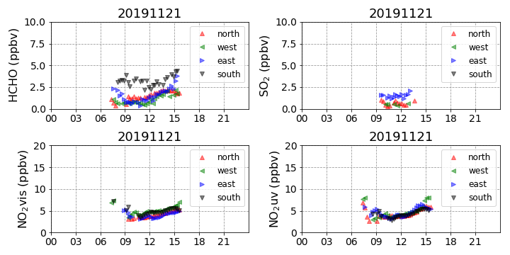
Trace Gas

Slide 2
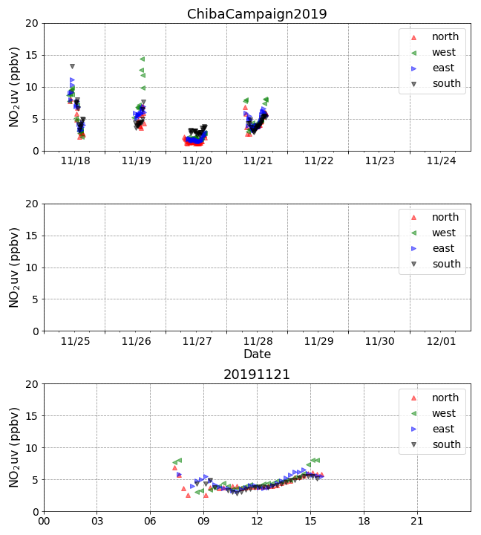
NO₂ time series

Slide 3
NO₂ time series
hour

Slide 4
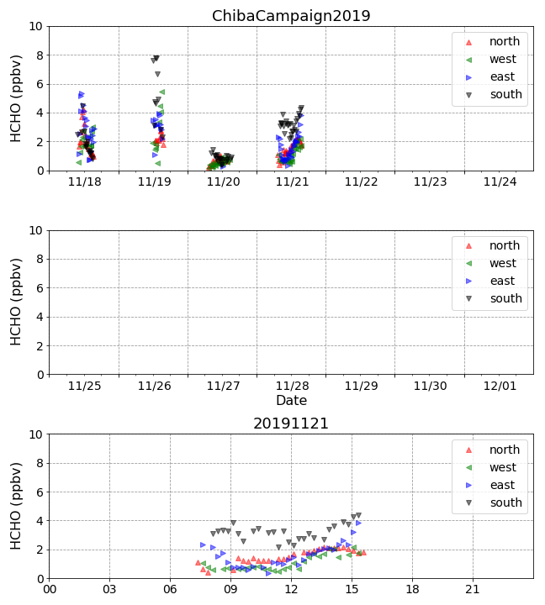
HCHO time series

Slide 5
HCHO time series
hour

